Slide 1

A Reactive Online Optimization Based Whole Body Control for Quadruped Locomotion Over Challenging Terrain
[CE554] Mechanical Design of Civil Robot
Team 2
20185570 - Hong Seung woo
20183633 – Choe JongHun
October 15, 2018
Notes:
첫 페이지

Slide 2
Table of Contents
Background
Research Plan
Notes:
목차

Slide 3
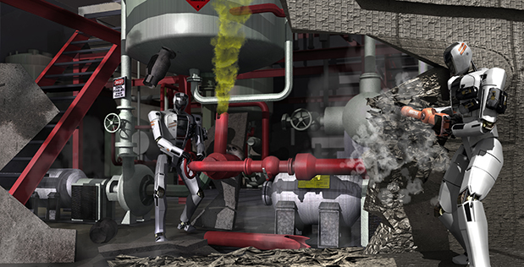
1. Background
l Motivation
Robots can perform the most hazardous activities in future disaster response operations in tandem with human counterparts
Disaster relief
Power plants inspection
Construction
Mars Exploration
Big themes of “Civil Robotics”
Notes:
통상적인 로봇 컨트롤 프레임워크에 대한 전반적인 설명

Slide 4
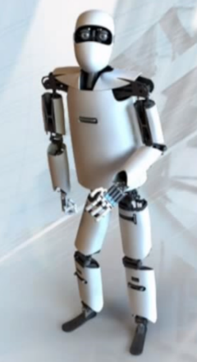
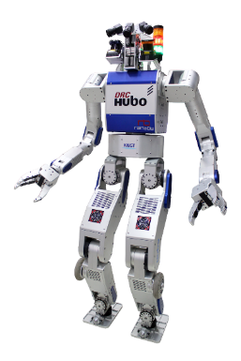
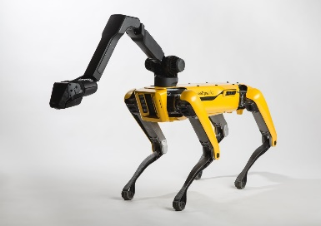
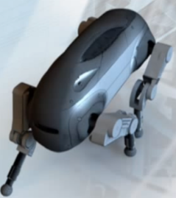
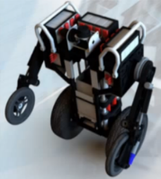
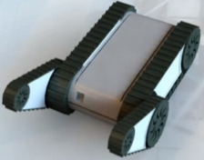
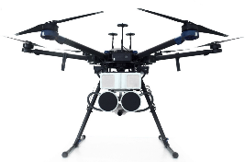
1. Background
l Motivation
Requirement to achieve this goal:
Locomotion: walking challenge over various types of terrain or structures
(ladders, stepping stones, big gaps, stairs, barriers, slopes, rocks, mud pit, rubble pile)
Manipulation: debris removal, pick and attach a hose to a pipe, open/close a valve
Commonly used robots:
Legged robots (Quadrupeds, Bipeds)
Wheeled / Tracked robots
Flying robots (UAVs, Drones)
Legged Robot
Legged Robot
Wheeled / Tracked Robot
Flying Robot
Notes:
통상적인 로봇 컨트롤 프레임워크에 대한 전반적인 설명

Slide 5
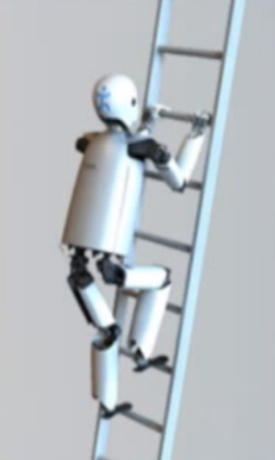
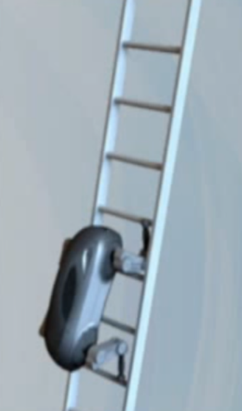

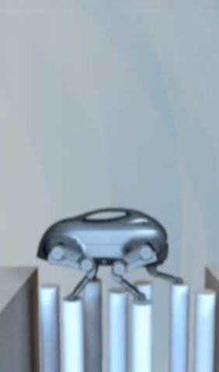
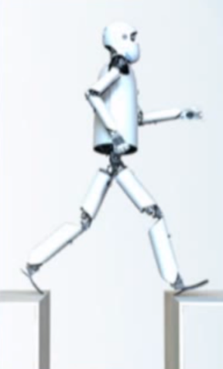
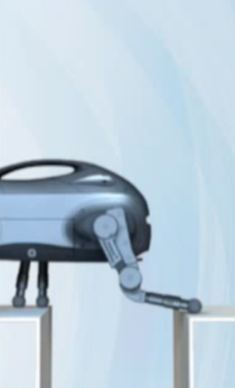
1. Background
l Why legged Robot?
Legged robot vs. Wheeled/Tracked robot
Ladders
Stepping
Stones
Big Gaps
Legged Robot
Wheeled /
Tracked Robot
Ladders
Stepping Stones
Big Gaps
Notes:
통상적인 로봇 컨트롤 프레임워크에 대한 전반적인 설명

Slide 6
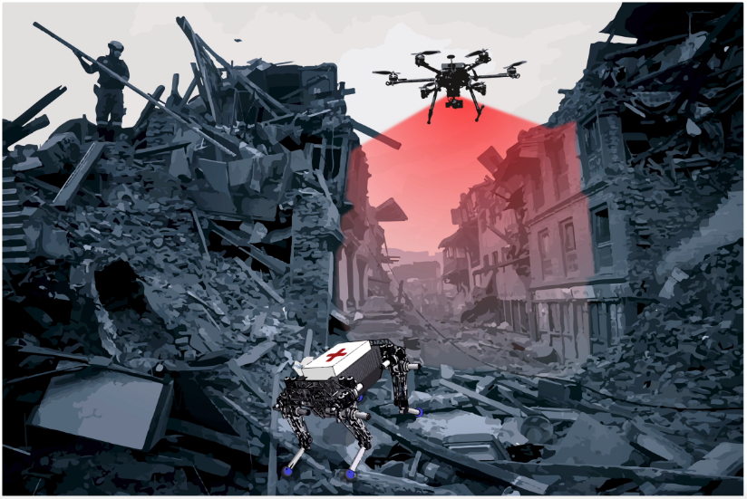
1. Background
l Why legged Robot?
Legged robot vs. Flying robot
Manipulability
Payload
Operation
Time
Sensing
View Point
Speed
Legged Robot
Flying Robot
Notes:
통상적인 로봇 컨트롤 프레임워크에 대한 전반적인 설명

Slide 7
1. Background
l Why legged Robot?
Legged robot vs. Wheeled/Tracked robot vs. Flying robot
Manipulability
Terrain
Adaptability
Payload
Operation
Time
Sensing
View Point
Speed
Legged Robot
Wheeled /
Tracked Robot
Flying Robot
Notes:
통상적인 로봇 컨트롤 프레임워크에 대한 전반적인 설명

Slide 8


1. Background
l Quadruped(4 legs) vs. Biped(2 legs)
Comparison between Quadruped and Biped
Support Polygon: smallest convex set including all contact points
Quadruped
Biped
Stability
Payload
Speed
Height
Weight
Quadruped
Biped
Notes:
통상적인 로봇 컨트롤 프레임워크에 대한 전반적인 설명

Slide 9
1. Background
l The major challenge of legged robot locomotion
Complexity: analyzing and predicting full-body behaviors is difficult in legged robots
Under-actuation (high number of degrees of freedom)
Dynamically changing constraints from the environment
The coordination of a large number of state variables and actions
Reactiveness: maintaining balance when subjected to disturbance
Large pushes
Slope: generates a mild slipping hazard
Rubble pile: full of uneven surface and trip hazards, some of the objects are free to move
Compliant behavior:
Interacting with unexpected perturbations better
Safe interaction and cooperation with humans
Fast and efficient algorithm: online real-time calculation is important for certain recovery behaviors
Communication rate is limited in disaster environments such as tunnel or underground
Notes:
통상적인 로봇 컨트롤 프레임워크에 대한 전반적인 설명

Slide 10
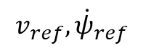
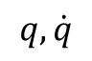
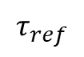
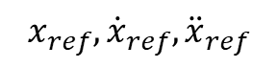
1. Background
l Research Goal – How we solve the problem
High-level controller: uses a simplified model that generates dynamically stable foot stepping location to reduce complexity of algorithm and reactive to disturbances
Low-level controller: uses a full body inverse dynamics providing compliant motions and robustness
$$v_{ref},{\dot{ψ}}_{ref}$$
Simplified Model
High-level controller
Outputs stable foot stepping location and trajectory
- Ease complexity
- Reactiveness
$$x_{ref},{\dot{x}}_{ref},{\ddot{x}}_{ref}$$
Full Body Model
Outputs optimal torque to track the trajectory using inverse dynamics
Low-level controller
- Highly Compliant
- Fast and efficient
(real-time)
$$τ_{ref}$$
Torque controlled
quadruped robot
Plant
$$q, \dot{q}$$
Notes:
통상적인 로봇 컨트롤 프레임워크에 대한 전반적인 설명

Slide 11
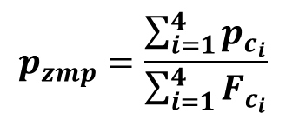
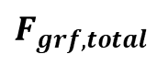


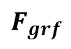

2. Research Plan
l High-level controller: generating dynamically stable foot stepping location
ZMP (Zero Moment Point): a point on the surface of the foot, where the resultant force passed
ZMP
$$F_{grf,total}$$
$F_{c_{i}}$: Contact forces
ZMP
$$ZMP$$
$p_{c_{i}}$: Contact positions
$$p_{zmp}=\frac{\sum_{i=1}^{4}{p_{c_{i}}}}{\sum_{i=1}^{4}{F_{c_{i}}}}$$
$$F_{grf}$$
Notes:
통상적인 로봇 컨트롤 프레임워크에 대한 전반적인 설명

Slide 12

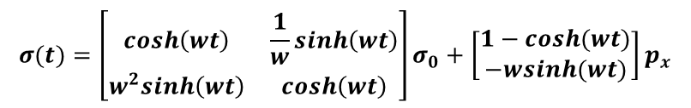
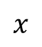
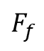
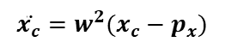
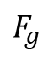
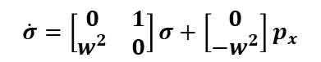
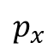
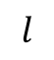
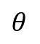
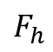
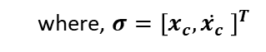
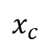
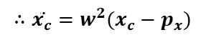

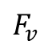
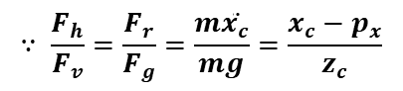
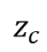
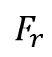
2. Research Plan
l High-level controller: generating dynamically stable foot stepping location
Simplified model: LIPM (Linear Inverted Pendulum Model)
$$F_{v}$$
$$F_{f}$$
Derivation
CoM
1) Equations of Motion:
$$z$$
$$∵ \frac{F_{h}}{F_{v}}=\frac{F_{r}}{F_{g}}=\frac{m\ddot{x_{c}}}{mg}=\frac{x_{c}−p_{x}}{z_{c}}$$
$$z_{c}$$
$$F_{h}$$
$$F_{r}$$
$$∴\ddot{x_{c}}=w^{2}(x_{c}−p_{x})$$
$$l$$
$$θ$$
$$F_{g}$$
2) Explicit solution of LIPM dynamics:
$$\dot{σ}=\left[\begin{matrix}0 & 1 \\ w^{2} & 0\end{matrix}\right]σ+\left[\begin{matrix}0 \\ −w^{2}\end{matrix}\right]p_{x}$$
ZMP
where, $σ={\left[x_{c},\dot{x_{c}} \right]}^{T}$
$$p_{x}$$
$$x$$
$$σ(t)=\left[\begin{matrix}cosh\left(wt\right) & \frac{1}{w}sinh\left(wt\right) \\ w^{2}sinh\left(wt\right) & cosh\left(wt\right)\end{matrix}\right]σ_{0}+\left[\begin{matrix}1−cosh(wt) \\ −wsinh(wt)\end{matrix}\right]p_{x}$$
$$x_{c}$$
where, $σ_{0}={\left[x_{c_{0}},\dot{x_{c_{0}}} \right]}^{T}$, is initial condition of the system
Equations of Motion:
$$\ddot{x_{c}}=w^{2}(x_{c}−p_{x})$$
Notes:
통상적인 로봇 컨트롤 프레임워크에 대한 전반적인 설명

Slide 13
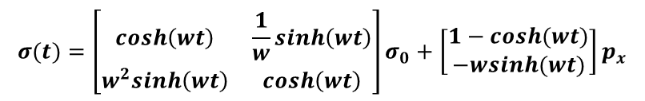
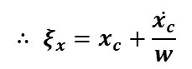
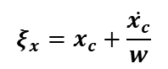
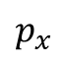
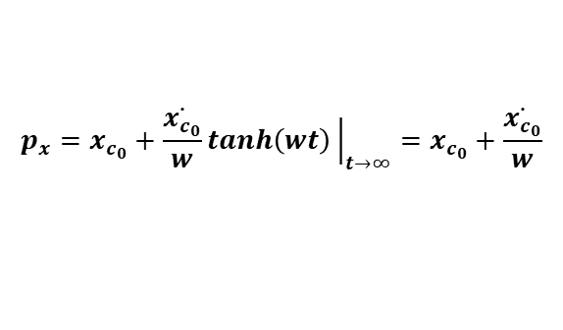
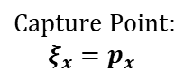
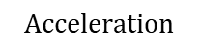
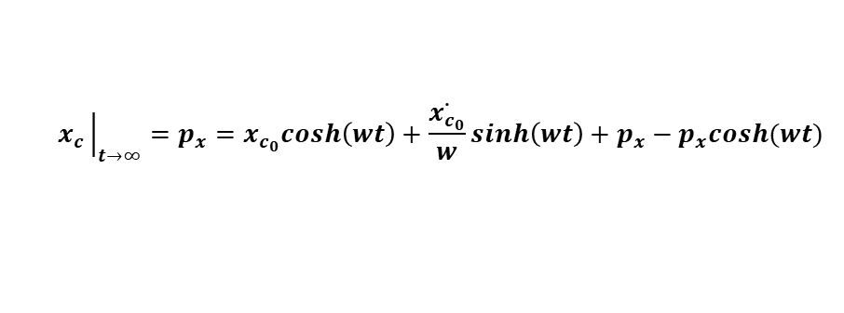
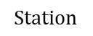
2. Research Plan
l High-level controller: generating dynamically stable foot stepping location
Capture point: a point that the robot can step to and stop in one step without falling
Derivation
$$Station$$
$$Acceleration$$
1) From explicit solution of LIPM dynamics:
$$σ(t)=\left[\begin{matrix}cosh\left(wt\right) & \frac{1}{w}sinh\left(wt\right) \\ w^{2}sinh\left(wt\right) & cosh\left(wt\right)\end{matrix}\right]σ_{0}+\left[\begin{matrix}1−cosh(wt) \\ −wsinh(wt)\end{matrix}\right]p_{x}$$
where, $σ_{0}={\left[x_{c_{0}},\dot{x_{c_{0}}} \right]}^{T}$, is initial condition of the system
2) Find $x_{c}→p_{x}$ when time tends towards infinity:
$$x_{c}{\left.​\right|}_{t→∞}=p_{x}=x_{c_{0}}cosh\left(wt\right)+\frac{\dot{x_{c_{0}}}}{w}sinh\left(wt\right)+p_{x}−p_{x}cosh(wt)$$
$$p_{x}$$
$$Capture Point:$$
$$ξ_{x}=p_{x}$$
$$p_{x}=x_{c_{0}}+\frac{\dot{x_{c_{0}}}}{w}tanh\left(wt\right){\left.​\right|}_{t→∞}=x_{c_{0}}+\frac{\dot{x_{c_{0}}}}{w}$$
Capture point:
$$∴ ξ_{x}=x_{c}+\frac{\dot{x_{c}}}{w}$$
$$ξ_{x}=x_{c}+\frac{\dot{x_{c}}}{w}$$
Notes:
통상적인 로봇 컨트롤 프레임워크에 대한 전반적인 설명

Slide 14
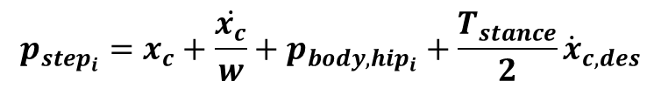
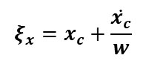
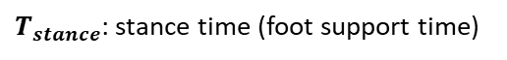

2. Research Plan
l High-level controller: generating dynamically stable foot stepping location
$p_{step_{i}}$ : a dynamically stable foot stepping location
Method
$$Station$$
$$Acceleration$$
$$p_{step_{i}}=x_{c}+\frac{\dot{x_{c}}}{w}+p_{body,hip_{i}}+\frac{T_{stance}}{2}{\dot{x}}_{c,des}$$
Capture point:
Feedback term:
Feedforward term:
$$ξ_{x}=x_{c}+\frac{\dot{x_{c}}}{w}$$
$p_{body,hip_{i}}$: torso center to $i_{th}$ hip offset
Capture point
$T_{stance}$: stance time (foot support time)
$$p_{x}$$
$x_{c},{\dot{x}}_{c}$ : easy to measure using kinematic information
$$Capture Point:$$
$$ξ_{x}=p_{x}$$
It is reactive to disturbances, even in the case of early stepping situation.
Notes:
통상적인 로봇 컨트롤 프레임워크에 대한 전반적인 설명

Slide 15








2. Research Plan
l High-level controller: generating dynamically stable foot stepping location
Foot trajectory generation: $5_{th}$ polynomial function
Method
$$Acceleration$$
$$x=P_{5}t^{5}+P_{4}t^{4}+P_{3}t^{3}+P_{2}t^{2}+P_{1}t+P_{0}$$
$$\dot{x}={5P}_{5}t^{4}+4P_{4}t^{3}+3P_{3}t^{2}+2P_{2}t+P_{1}$$
$$\ddot{x}={20P}_{5}t^{3}+12P_{4}t^{2}+6P_{3}t+2P_{2}$$
$Let, A=\left[\begin{matrix}t_{i}^{5} & t_{i}^{4} & t_{i}^{3} & t_{i}^{2} & t_{i}^{1} & t_{i}^{0} \\ 5t_{i}^{4} & 4t_{i}^{3} & 3t_{i}^{2} & 2t_{i}^{1} & t_{i}^{0} & 0 \\ 20t_{i}^{3} & 12t_{i}^{2} & 6t_{i}^{1} & 2t_{i}^{0} & 0 & 0 \\ t_{f}^{5} & t_{f}^{4} & t_{f}^{3} & t_{f}^{2} & t_{f}^{1} & t_{f}^{0} \\ 5t_{f}^{4} & 4t_{f}^{3} & 3t_{f}^{2} & 2t_{f}^{1} & t_{f}^{0} & 0 \\ 20t_{f}^{3} & 12t_{f}^{2} & 6t_{f}^{1} & 2t_{f}^{0} & 0 & 0\end{matrix}\right]$ ,
$B=\left[\begin{matrix}x_{i} \\ {\dot{x}}_{i} \\ {\ddot{x}}_{i} \\ x_{f} \\ {\dot{x}}_{f} \\ {\ddot{x}}_{f}\end{matrix}\right]$ ,
$$p_{step_{i−1}}$$
$$p_{step_{i}}$$
where, $t_{i}$ : initial time
$t_{f}$ : the end of step time
$x_{i}$, ${\dot{x}}_{i}$, ${\ddot{x}}_{i}$, $x_{f}$, ${\dot{x}}_{f},{\ddot{x}}_{f}$: initial and final position,
velocity, acceleration respectively
Notes:
통상적인 로봇 컨트롤 프레임워크에 대한 전반적인 설명

Slide 16




2. Research Plan
l High-level controller: generating dynamically stable foot stepping location
Foot trajectory generation: $5_{th}$ polynomial function
Method
$$Acceleration$$
1) Let $x_{i}=p_{step_{i−1}}$, $x_{f}=p_{step_{i}}$, ${\dot{x}}_{i}={\ddot{x}}_{i}={\dot{x}}_{f}={\ddot{x}}_{f}=0,$
Calculate: $P=\left[\begin{matrix}P_{5} \\ P_{4} \\ P_{3} \\ P_{2} \\ P_{1} \\ P_{0}\end{matrix}\right]=A^{−1}B$
$${∴x}_{foot}=P{\left[t^{5} t^{4} t^{3} t^{2} t 1\right]}^{T}$$
$${\dot{x}}_{foot}=P{\left[{5t}^{4} {4t}^{3} 3t^{2} 2t 1 0\right]}^{T}$$
$$p_{step_{i−1}}$$
$$p_{step_{i}}$$
$${\ddot{x}}_{foot}=P{\left[{20t}^{3} 12t^{2} 6t 2 0 0\right]}^{T}$$
Notes:
통상적인 로봇 컨트롤 프레임워크에 대한 전반적인 설명

Slide 17























2. Research Plan
l Low-level controller: optimization based inverse dynamics control
$q$: generalized coordinates in joint space
Floating base multi-body dynamics
$$q={\left[q_{b},q_{a}\right]}^{T}∈ℝ^{18×1}$$
$$z$$
Body frame
$$y$$
$q_{b}$ : under-actuated base coordinates
Under-actuated
base coordinates
$$x$$
$$q_{b}={\left[x,y,z,q_{roll},q_{pitch},q_{yaw}\right]}^{T}∈ℝ^{6×1}$$
$q_{a}$ : actuated joint coordinates
$$q_{a}∈ℝ^{12×1}$$
$$z$$
$x_{c}$: contact vector in Cartesian space
$$y$$
$$x_{c}∈ℝ^{3×1}$$
$$x$$
$F_{c}$: Contact forces
$M(q)$ : mass matrix
Inertial frame
$h(q,\dot{q})$ : sum of Coriolis, centrifugal, gravitational forces
Equations of Motion:
$τ$ : actuator torque
$$M\left(q\right)\ddot{q}+h\left(q,\dot{q}\right)−J_{c}{\left(q\right)}^{T}F_{c}=S^{T}τ$$
$S$ : selection matrix
$$S=[0_{12×6} I_{12}]∈ℝ^{12×18}$$
Constraint Equations:
$F_{c}$ : contact forces
$x_{c}=const$
${\dot{x}}_{c}=J_{c}\dot{q}=0$
${\ddot{x}}_{c}=J_{c}\ddot{q}+{\dot{J}}_{c}\dot{q}=0$
$$F_{c}∈ℝ^{3n_{c}×1} (n_{c}:number of contact points)$$
$J_{c}$ : support Jacobian
$$J_{c}∈ℝ^{3n_{c}×18} (n_{c}:number of contact points)$$
Notes:
통상적인 로봇 컨트롤 프레임워크에 대한 전반적인 설명

Slide 18











2. Research Plan
l Low-level controller: optimization based inverse dynamics control
Quadratic programming:
Formulate inverse dynamics as QP problem:
$$\min_{X}{\frac{1}{2}X^{T}GX+g^{T}X}$$
$$s.t. C_{E}X+c_{E} = 0$$
$C_{I}X+c_{I}≥0$
Equality Constraint
1) Equations of Motion
$$\left[M\left(q\right) −S^{T} −J_{c}{\left(q\right)}^{T}\right]\left[\begin{matrix}\ddot{q} \\ τ \\ F_{c}\end{matrix}\right]=−b\left(q,\dot{q}\right)−g\left(q\right)$$
Optimize a cost function of the form:
$$\frac{1}{2}{\left\|AX−b\right\|}^{2}$$
where, $G=A^{T}A, g=−A^{T}b$
Inequality Constraint
$A$ and $b$ can be decomposed into smaller blocks:
1) Contact constraint
${\ddot{x}}_{c}=J_{c}\ddot{q}+{\dot{J}}_{c}\dot{q}=0$
$$A=\left[\begin{aligned}&{w_{1}A}_{1} \\ &w_{2}A_{2} \\ ⋮ \\ {w_{n}A}_{n}\end{aligned}\right], b=\left[\begin{aligned}&{w_{1}b}_{1} \\ &w_{2}b_{2} \\ ⋮ \\ w_{n}b_{n}\end{aligned}\right]$$
2) Friction cone approximation
$$\left|f_{x}\right|≤μf_{z}$$
where, $μ$: frictional coefficient
※ Each row emphasizes a desired
behavior with weight $w_{i}$
$$\left|f_{y}\right|≤μf_{z}$$
Notes:
통상적인 로봇 컨트롤 프레임워크에 대한 전반적인 설명

Slide 19











2. Research Plan
l Low-level controller: optimization based inverse dynamics control
Formulate inverse dynamics as QP problem:
Cost Function
2) Cartesian space acceleration
$$A=\left[\begin{aligned}&{w_{1}A}_{1} \\ &w_{2}A_{2} \\ ⋮ \\ {w_{n}A}_{n}\end{aligned}\right], b=\left[\begin{aligned}&{w_{1}b}_{1} \\ &w_{2}b_{2} \\ ⋮ \\ w_{n}b_{n}\end{aligned}\right]$$
$$∵{\ddot{x}}_{des}=J\left(q\right){\ddot{q}}_{des}+\dot{J}\left(q,\dot{q}\right)\dot{q}$$
$$A_{cart}=\left[\begin{matrix}J(q) & 0 & 0\end{matrix}\right]$$
$$b_{cart}={\ddot{x}}_{des}−\dot{J}\left(q,\dot{q}\right)\dot{q}$$
※ Each row emphasizes a desired
behavior with weight $w_{i}$
$${\ddot{x}}_{des}=K_{p}\left(x_{ref}−x\right)+K_{d}\left({\dot{x}}_{ref}−\dot{x}\right)+{\ddot{x}}_{ref}$$
3) Direct tracking and regularization
$$A_{state}=I$$
1) Joint space acceleration
$$b_{joint}={\ddot{q}}_{des}$$
$$A_{joint}=\left[\begin{matrix}I & 0 & 0\end{matrix}\right]$$
$$b_{joint}={\ddot{q}}_{des}$$
4) Changes in torques
$${\ddot{q}}_{des}=K_{p}\left(q_{ref}−q\right)+K_{d}\left({\dot{q}}_{ref}−\dot{q}\right)+{\ddot{q}}_{ref}$$
$$A_{cart}=\left[\begin{matrix}0 & I & 0\end{matrix}\right]$$
$$b_{joint}=τ_{previous}$$
Notes:
통상적인 로봇 컨트롤 프레임워크에 대한 전반적인 설명

Slide 20
2. Research Plan
l Low-level controller: optimization based inverse dynamics control
Formulate inverse dynamics as QP problem:
Cost Function
2) Cartesian space acceleration
$$A=\left[\begin{aligned}&{w_{1}A}_{1} \\ &w_{2}A_{2} \\ ⋮ \\ {w_{n}A}_{n}\end{aligned}\right], b=\left[\begin{aligned}&{w_{1}b}_{1} \\ &w_{2}b_{2} \\ ⋮ \\ w_{n}b_{n}\end{aligned}\right]$$
$$∵{\ddot{x}}_{des}=J\left(q\right){\ddot{q}}_{des}+\dot{J}\left(q,\dot{q}\right)\dot{q}$$
$$A_{cart}=\left[\begin{matrix}J(q) & 0 & 0\end{matrix}\right]$$
$$b_{cart}={\ddot{x}}_{des}−\dot{J}\left(q,\dot{q}\right)\dot{q}$$
※ Each row emphasizes a desired
behavior with weight $w_{i}$
$${\ddot{x}}_{des}=K_{p}\left(x_{ref}−x\right)+K_{d}\left({\dot{x}}_{ref}−\dot{x}\right)+{\ddot{x}}_{ref}$$
3) Direct tracking and regularization
$$A_{state}=I$$
1) Joint space acceleration
$$b_{joint}={\ddot{q}}_{des}$$
$$A_{joint}=\left[\begin{matrix}I & 0 & 0\end{matrix}\right]$$
$$b_{joint}={\ddot{q}}_{des}$$
4) Changes in torques
$${\ddot{q}}_{des}=K_{p}\left(q_{ref}−q\right)+K_{d}\left({\dot{q}}_{ref}−\dot{q}\right)+{\ddot{q}}_{ref}$$
$$A_{cart}=\left[\begin{matrix}0 & I & 0\end{matrix}\right]$$
$$b_{joint}=τ_{previous}$$
Notes:
통상적인 로봇 컨트롤 프레임워크에 대한 전반적인 설명

Slide 21
2. Research Plan
l Low-level controller: optimization based inverse dynamics control
Formulate inverse dynamics as QP problem:
Cost Function
2) Cartesian space acceleration
$$A=\left[\begin{aligned}&{w_{1}A}_{1} \\ &w_{2}A_{2} \\ ⋮ \\ {w_{n}A}_{n}\end{aligned}\right], b=\left[\begin{aligned}&{w_{1}b}_{1} \\ &w_{2}b_{2} \\ ⋮ \\ w_{n}b_{n}\end{aligned}\right]$$
$$∵{\ddot{x}}_{des}=J\left(q\right){\ddot{q}}_{des}+\dot{J}\left(q,\dot{q}\right)\dot{q}$$
$$A_{cart}=\left[\begin{matrix}J(q) & 0 & 0\end{matrix}\right]$$
$$b_{cart}={\ddot{x}}_{des}−\dot{J}\left(q,\dot{q}\right)\dot{q}$$
※ Each row emphasizes a desired
behavior with weight $w_{i}$
$${\ddot{x}}_{des}=K_{p}\left(x_{ref}−x\right)+K_{d}\left({\dot{x}}_{ref}−\dot{x}\right)+{\ddot{x}}_{ref}$$
3) Direct tracking and regularization
$$A_{state}=I$$
1) Joint space acceleration
$$b_{joint}={\ddot{q}}_{des}$$
$$A_{joint}=\left[\begin{matrix}I & 0 & 0\end{matrix}\right]$$
$$b_{joint}={\ddot{q}}_{des}$$
4) Changes in torques
$${\ddot{q}}_{des}=K_{p}\left(q_{ref}−q\right)+K_{d}\left({\dot{q}}_{ref}−\dot{q}\right)+{\ddot{q}}_{ref}$$
$$A_{cart}=\left[\begin{matrix}0 & I & 0\end{matrix}\right]$$
$$b_{joint}=τ_{previous}$$
Notes:
통상적인 로봇 컨트롤 프레임워크에 대한 전반적인 설명

Slide 22



2. Research Plan
Baseline (Comparison Target)
Push Recovery
Walking on Sloped Terrain
Dynamic Locomotion

Slide 23
2. Research Plan
l Expected contribution
Design a dynamic locomotion control framework
Dividing a complex planning and control problem into different levels
Reactive to large disturbances
Highly compliant
Overall problem can be solved online
Notes:
통상적인 로봇 컨트롤 프레임워크에 대한 전반적인 설명

Slide 24
References
Aghili F (2005) A unified approach for inverse and direct dynamics of constrained multibody systems based on linear projection operator: Applications to control and simulation. IEEE Transactions on Robotics 21(5): 834–849.
Bouyarmane, K., Vaillant, J., Keith, F., & Kheddar, A. (2012). Exploring humanoid robots locomotion capabilities in virtual disaster response scenarios. In 12th IEEE-RAS International Conference on Humanoid Robots (Humanoids) (pp. 337–342), Osaka, Japan.
De Lasa, M., Mordatch, I., & Hertzmann, A. (2010). Featurebased locomotion controllers. ACM Transactions on Graphics, 29(4), 131:1–131:10.
Khatib O (1987) A unified approach for motion and force control of robot manipulators: The operational space formulation. IEEE Journal of Robotics and Automation 3(1): 43–53.
Herzog, A., Righetti, L., Grimminger, F., Pastor, P., & Schaal, S. (2014). Balancing experiments on a torque-controlled humanoid with hierarchical inverse dynamics. In IEEE/RSJ International Conference on Intelligent Robots and Systems (IROS), Chicago.
Hutter, M., Sommer, H., Gehring, C., Hoepflinger, M., Bloesch, M., & Siegwart, R. (2014). Quadrupedal locomotion using hierarchical operational space control. The International Journal of Robotics Research, 33(8), 1047–1062.
Feng, S., Whitman, E., Xinjilefu, X., & Atkeson, C. G. (2015). Optimization‐based full body control for the DARPA Robotics Challenge. Journal of Field Robotics, 32(2), 293-312.
Mistry M, Buchli J and Schaal S (2010) Inverse dynamics control of floating base systems using orthogonal decomposition. In: Proceedings of International conference on robotics and automation (ICRA), Anchorage, AK, 3–8 May 2010, pp. 3406–3412.
Sentis L (2007) Synthesis and control of whole-body behaviors in humanoid systems. PhD Thesis, Stanford University.
Raibert, M. H. (1986). Legged robots that balance. MIT press.
Vukobratović, M., & Borovac, B. (2004). Zero-moment point—thirty five years of its life. International journal of humanoid robotics, 1(01), 157-173.
Pratt, J., Carff, J., Drakunov, S., & Goswami, A. (2006, December). Capture point: A step toward humanoid push recovery. In Humanoid Robots, 2006 6th IEEE-RAS International Conference on (pp. 200-207). IEEE.
Rebula, J., Canas, F., Pratt, J., & Goswami, A. (2007, November). Learning capture points for humanoid push recovery. In Humanoid Robots, 2007 7th IEEE-RAS International Conference on (pp. 65-72). IEEE.

Slide 25


